Slide 1
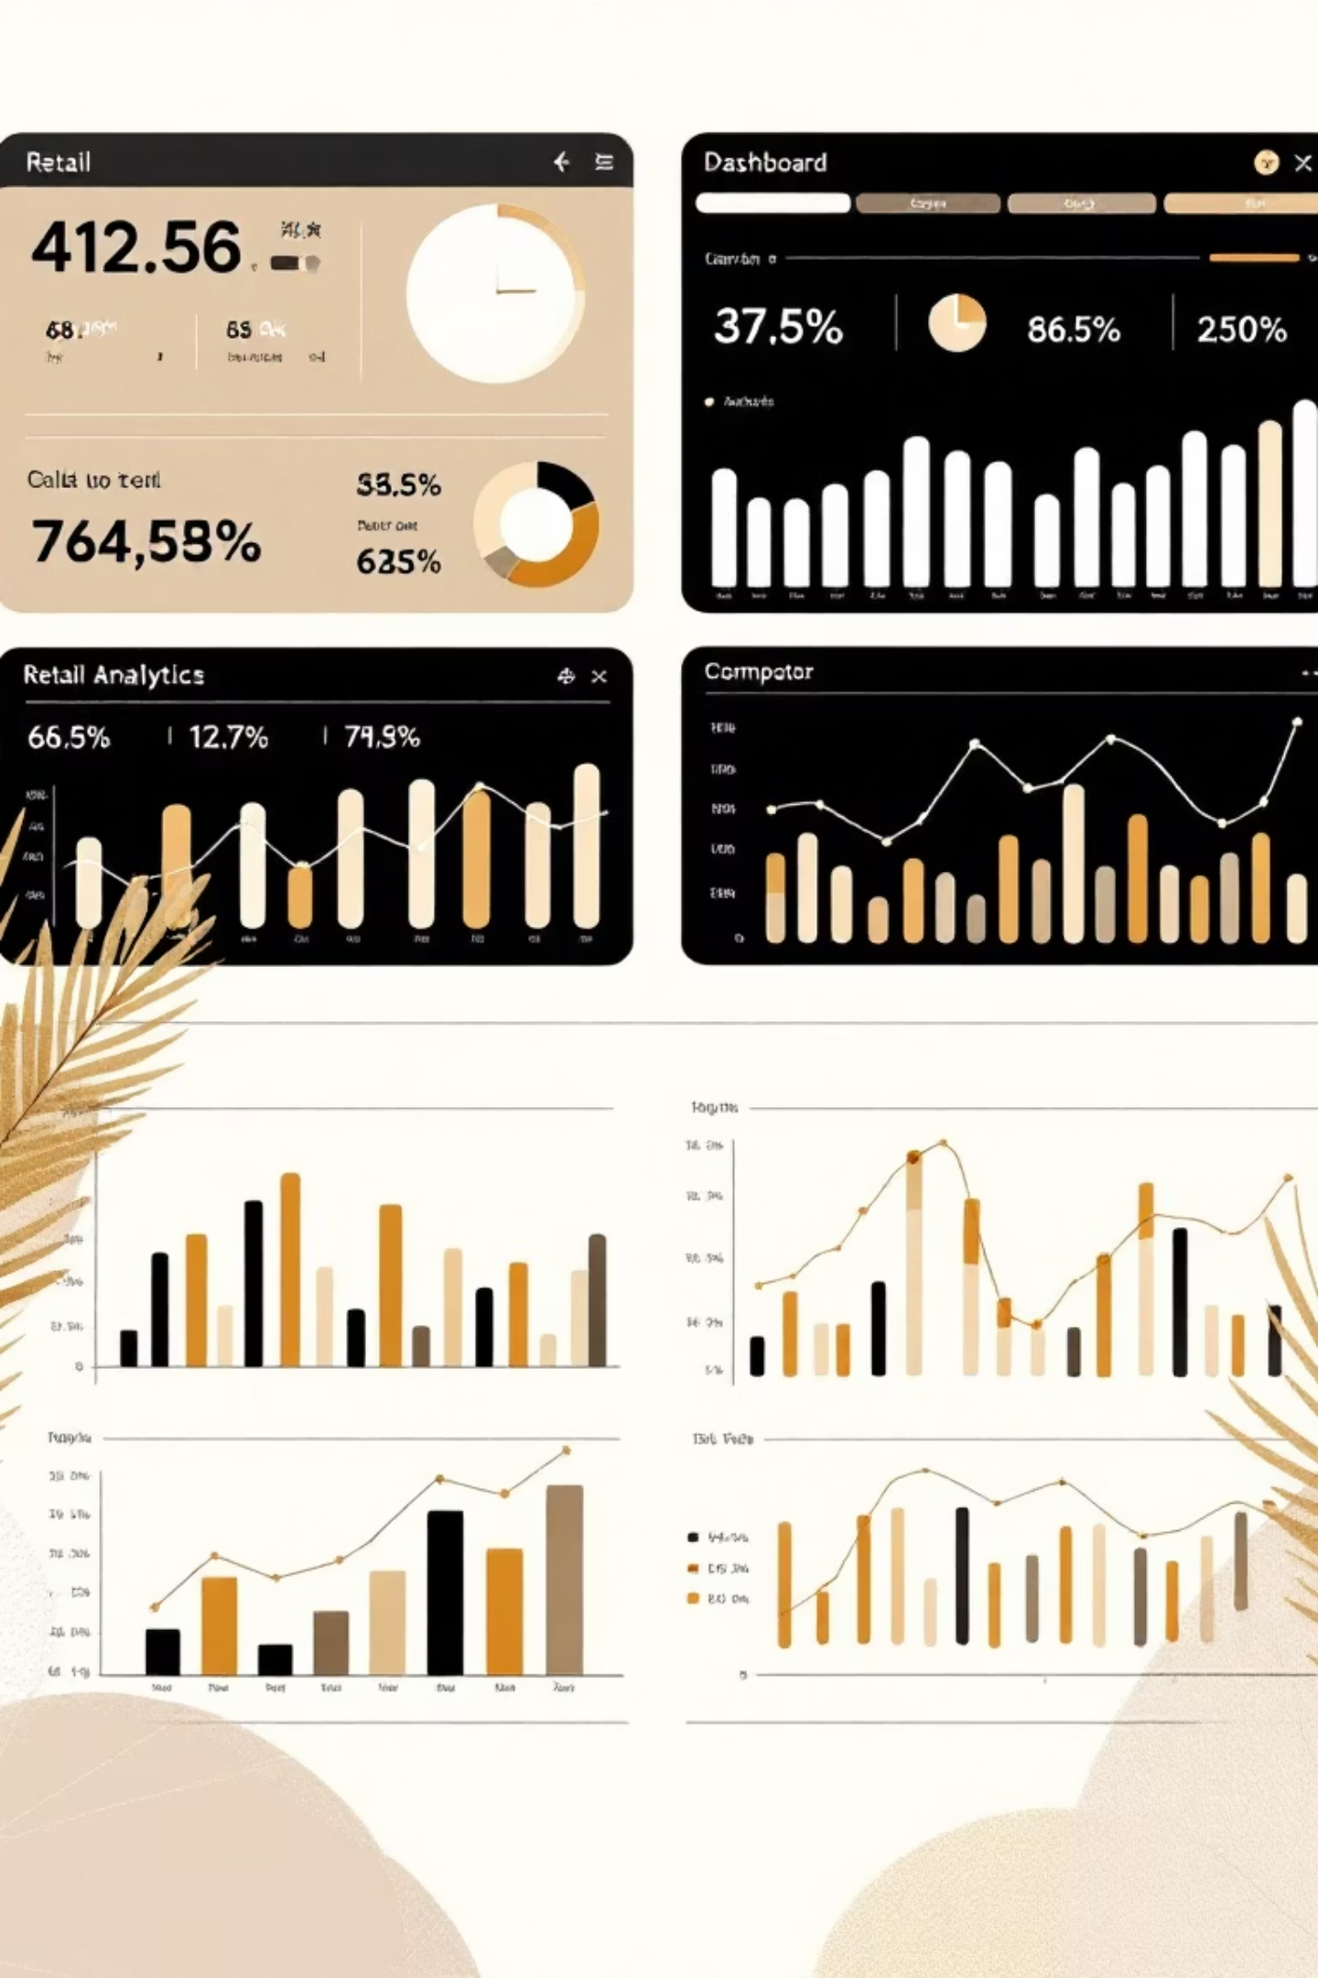
Customer Shopping Behavior Analysis
Uncovering insights from 3,900 purchases to drive strategic business decisions

Slide 2
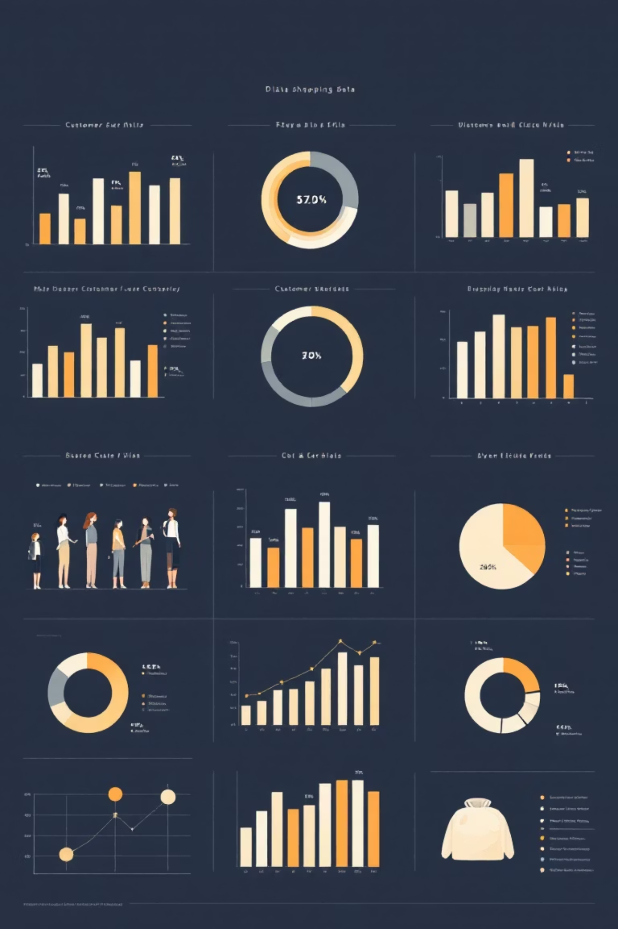

DATASET OVERVIEW
The Foundation
3,900
18
50
Total Purchases
Data Points
Locations
Transactions analyzed across all categories
Columns tracking customer behavior
Geographic coverage nationwide
25
Products
Unique items purchased

Slide 3


DATA PREPARATION
Python Analysis Pipeline
01
02
Data Loading & Exploration
Missing Data Handling
Imported dataset, checked structure with df.info() and summary statistics
Imputed 37 missing Review Ratings using median by category
03
04
Feature Engineering
Database Integration
Created age_group bins and purchase_frequency_days columns
Connected to PostgreSQL for advanced SQL analysis

Slide 4
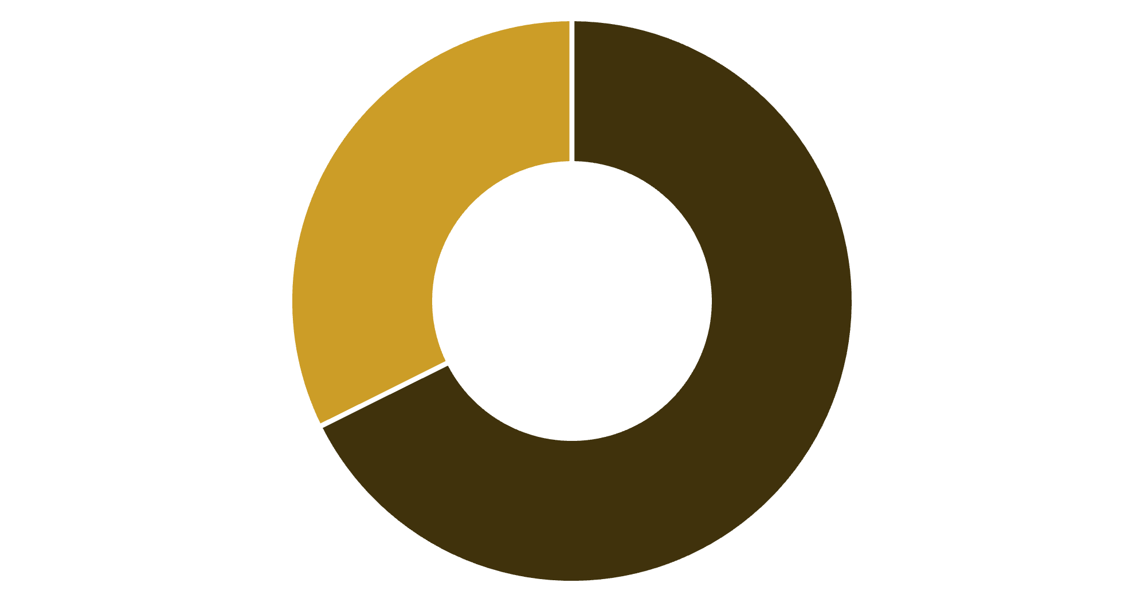
REVENUE INSIGHTS
Gender Revenue Breakdown
Key Finding
Male customers generate 68% of total revenue, more than double female contribution
Strategic opportunity for targeted marketing campaigns
Male
Female

Slide 5



Customer Segmentation
New
1
83 customers
Returning
2
701 customers
Loyal
3
3,116 customers
80% of customers are loyal – retention strategies are working, but growth opportunities exist in converting new buyers

Slide 6

PRODUCT PERFORMANCE
Top-Rated Products
1
2
3
Gloves
Sandals
Boots
3.86 average rating
3.84 average rating
3.82 average rating
4
5
Hat
Skirt
3.80 average rating
3.78 average rating

Slide 7
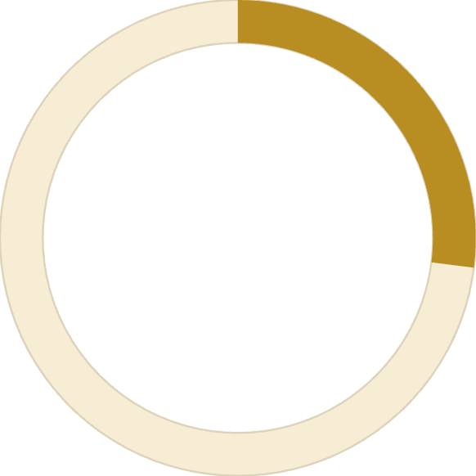
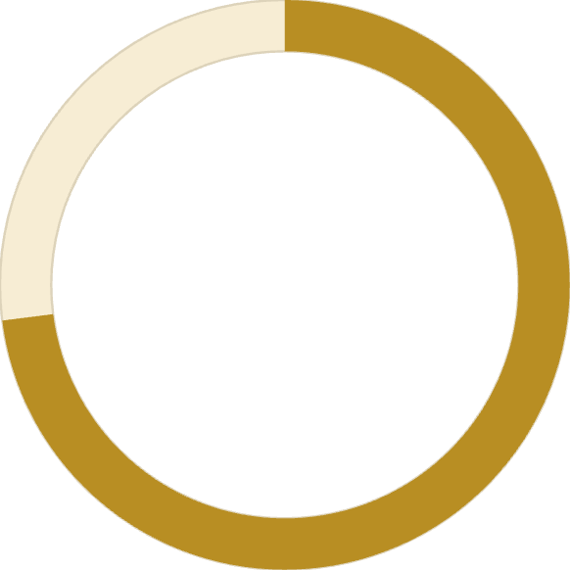
Subscription Analysis
Spending Patterns
Subscribers: $59.49 average spend
Non-subscribers: $59.87 average spend
27%
Minimal difference suggests untapped subscription value
Subscribers
1,053 customers with subscriptions
73%
Non-Subscribers
2,847 customers without subscriptions

Slide 8


DISCOUNT IMPACT
Discount-Dependent Products
50%
49.7%
49.1%
Hat
Sneakers
Coat
Highest discount rate
48.2%
47.4%
Sweater
Pants
839 customers used discounts but still spent above average – opportunity to optimize discount strategy

Slide 9
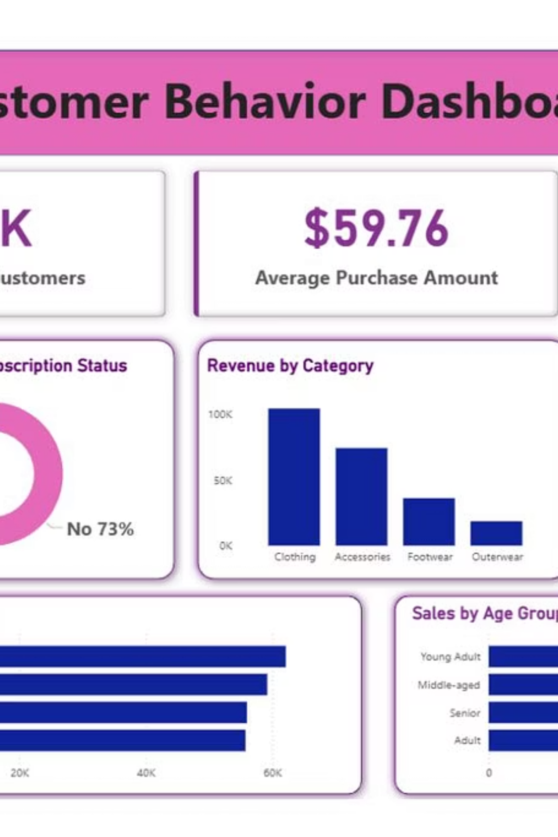
Power BI Dashboard
Interactive visualization bringing all insights together for real-time decision making

Slide 10






STRATEGIC RECOMMENDATIONS
Action Plan
Boost Subscriptions
Promote exclusive benefits to convert 73% non-subscribers
Loyalty Programs
Reward repeat buyers to strengthen 80% loyal base
Optimize Discounts
Balance sales boosts with margin control on high-discount items
Targeted Marketing
Focus on high-revenue segments and top-rated products

